Slide 1
Using Standardization as a Springboard for Academic Research: The Case of E-Impact and the Environment
The IETF edition
Alexander Pelov
IMT Atlantique
CoReS / AlgoTel 2024 – St. Briac-sur-Mer, France

Slide 2

The Environment
Photo: Yannick LE GAL
Source: https://www.camping-saint-briac.com/en/beaches/
Notes:
Ight res

Slide 3

Your Research
Source photo: ChatGPT4o

Slide 4
Hypothesis
Ideas
Models
Your Research
Papers
Evaluation
Results

Slide 5
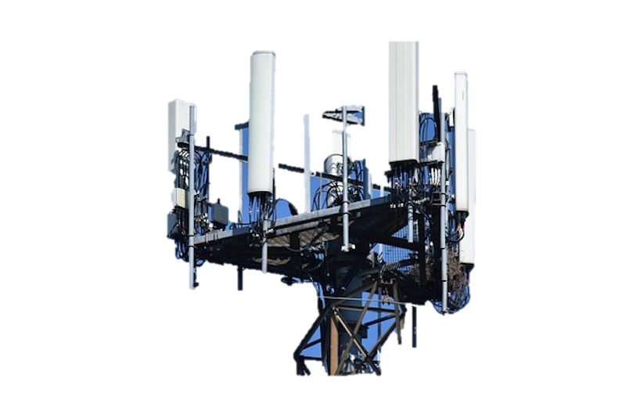
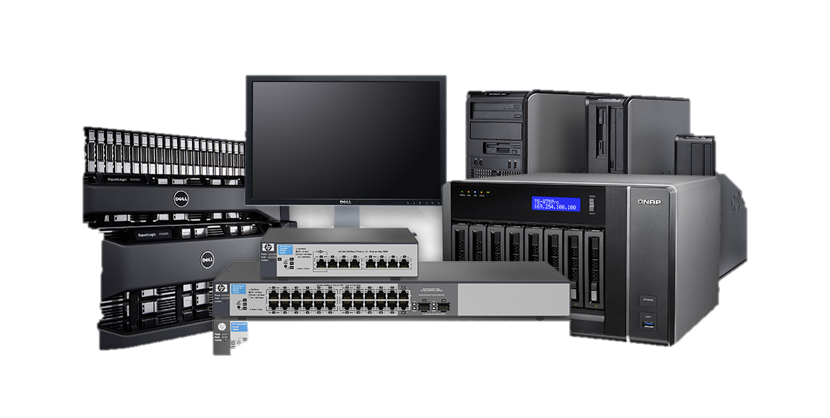
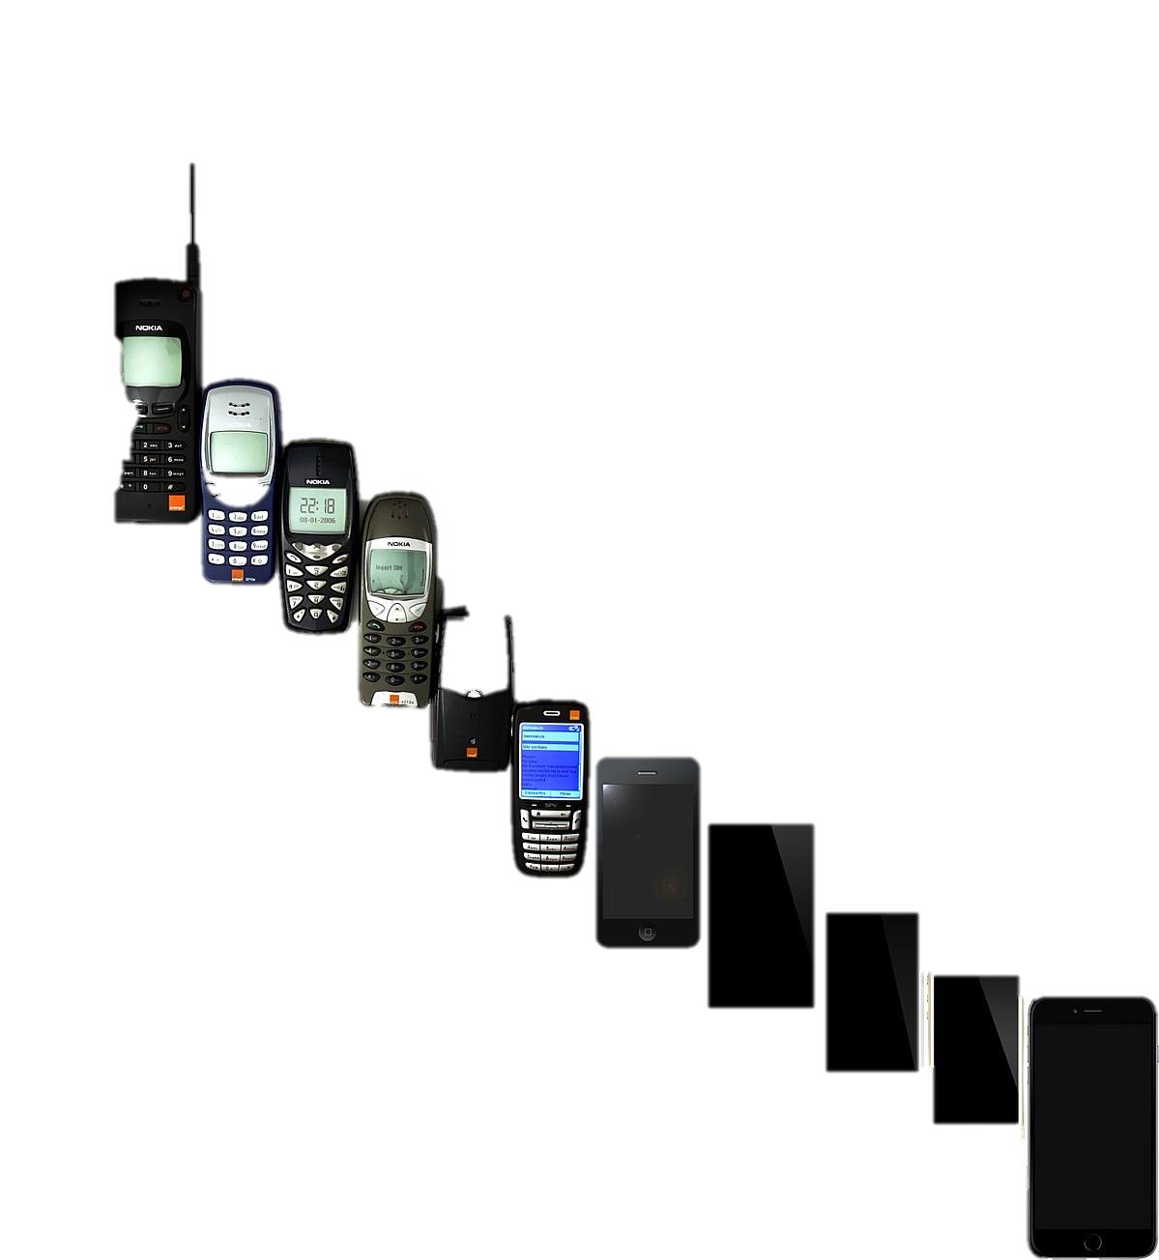
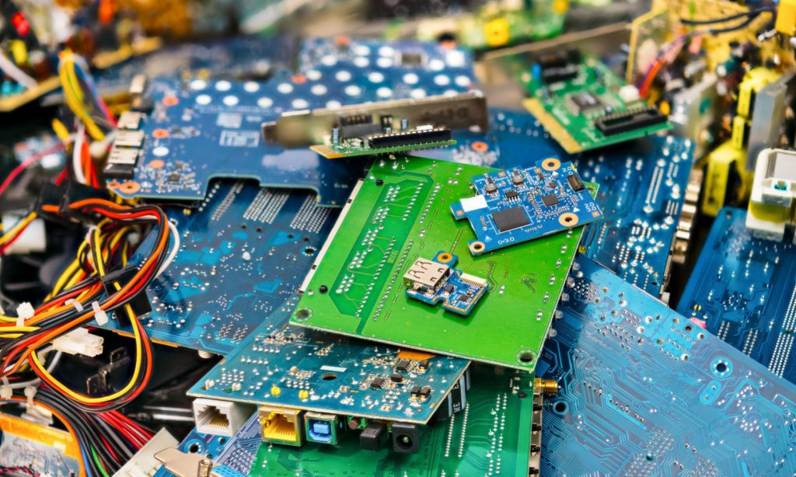
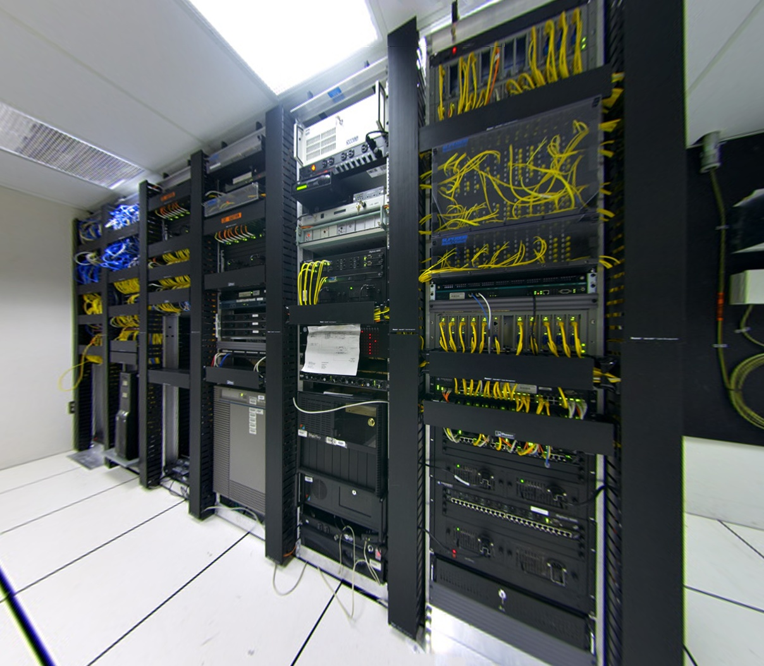
Hypothesis
Ideas
Models
Internet & Co
Your Research
Papers
Evaluation
Results

Slide 6
Hypothesis
Ideas
Models
Environment
Internet & Co
Your Research
Papers
Evaluation
Results

Slide 7
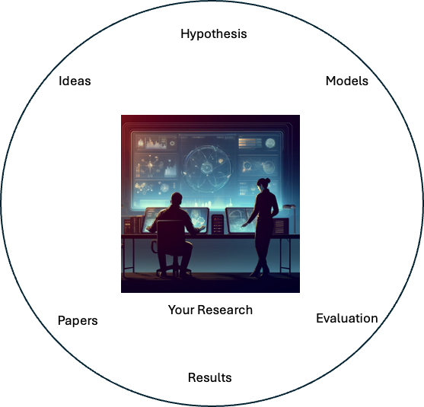
18 months
Environment
Understanding the benefits
Getting the solution to be known
Internet & Co
Writing the (industrialized) code
Standardizing
Understanding the limits
Making the hardware
4-12 years

Slide 8
18 months
Most of the times, your research cannot be implemented.
Things like: “my protocol is 25% better than IETF’s”
doesn’t matter on their own.
In lots of cases, the 25% come from unreasonable operational assumptions, or don’t cover the full communication stack (e.g. no security), or don’t work in all scenarios, or require rewriting the whole Internet, etc. etc. etc.
Environment
Understanding the benefits
Getting the solution to be known
Internet & Co
Writing the (industrialized) code
Standardizing
Understanding the limits
Making the hardware
4-12 years-Never

Slide 9
1 (or more) papers
+ Getting experience and contacts
+ Maybe multiple drafts / standards
Environment
Writing the (industrialized) code
Standardizing
Internet & Co
Understanding the benefits
Making the hardware
Understanding the limits
Getting the solution to be known
2-5 years*

Slide 10
Some real-world examples
Bruce Nordman <bnordman@lbl.gov>
In 2005 I co-proposed Energy Efficient Ethernet to IEEE 802.3.
In 2006 a working group was created and in early 2007 it had its first meeting.
Final approval was early 2010 by my recollection but products were appearing in late 2009.
Early on I did an estimate that showed on the order of $1 billion/year of savings globally, but over a few years the chips became significantly more efficient in general and so the EEE savings dropped - ballpark I would guess to a third but I really don't know.
Static Context Header Compression – SCHC
LoRa™ ,and Sigfox™ born in France ~2005-2012
Up to 90% less data, 70% less energy, 7x more devices per cell
The research on SCHC started roughly in 2012/2013
IETF WG forming in 2016
RFC 8724 published in 2020
Adopted by other SDOs in 2020
LoRa Alliance & DLMS UA & IEC
First smart meters deployed in a pilot – 2021
Today, there are 20k+ gas meters, 1k+ electric and 1k+ water meters deployed
In 2026: 7M in Italy, 560k in Greece
8 RFCs, 8 drafts in work, many more in related WG
Multiple standards from other SDOs
Current work for the future:
SCHC for 6G and WiFi Zero-Energy devices

Slide 11
If you are working on networking (in any way),
you SHOULD participate in the standardization process
If you want your work to have larger impact,
you SHOULD participate in the standardization process
If you want to confront your ideas and research,
you SHOULD participate in the standardization process

Slide 12
What is the IETF? Internet Engineering Task Force
The IETF makes voluntary standards that are often adopted.
The overall goal of the IETF is to make the Internet work better.
There is no membership in the IETF. Anyone can participate by signing up to a working group mailing list.
Mantra:
“We reject kings, presidents and voting. We believe in rough consensus and running code.”
https://www.ietf.org/participate/get-started/
Approximate order of places of in-person meetings (can vary):
Asia*
North America
Europe
March
July
November
See RFC3935 (« Mission Statement ») and RFC7282 (« On Consensus and Humming in the IETF »)
*Or South America, Africa, Australia

Slide 13
Source: https://www.ietf.org/meeting/new-participants/ Document: https://www.ietf.org/media/documents/NewParticipant-Overview-Recordings_2022.pdf

Slide 14
Source: https://www.ietf.org/meeting/new-participants/ Document: https://www.ietf.org/media/documents/NewParticipant-Overview-Recordings_2022.pdf

Slide 15
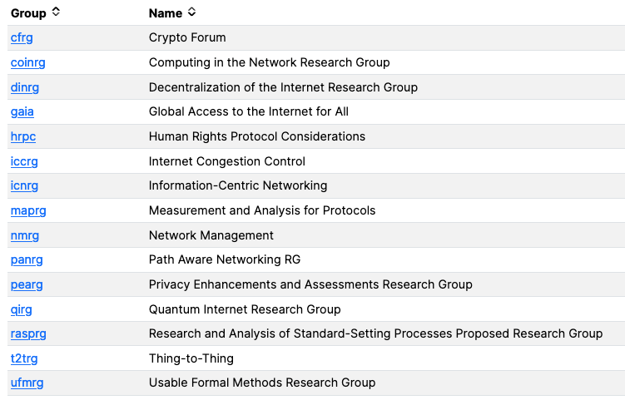
The Internet Research Task Force (IRTF) focuses on longer term research issues related to the Internet while the parallel organization, the Internet Engineering Task Force (IETF), focuses on the shorter-term issues of engineering and standards making.

Slide 16
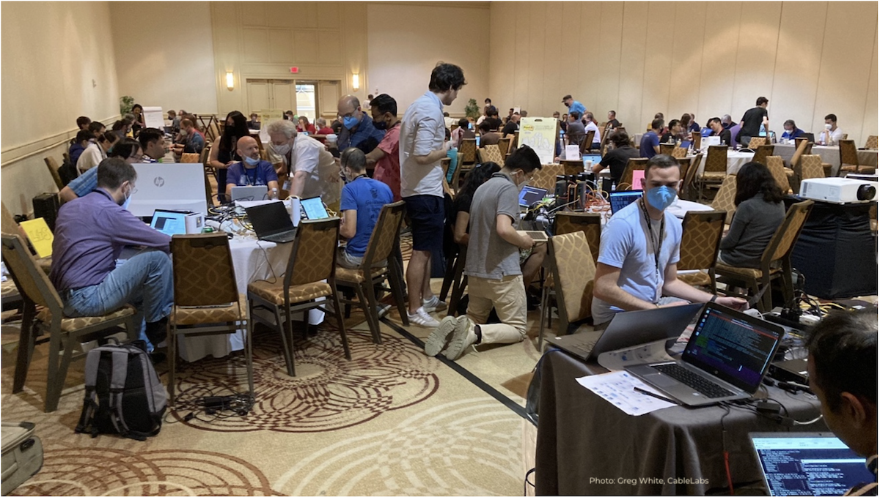
Hackathon
Source: https://www.ietf.org/blog/ietf114-hackathon/

Slide 17
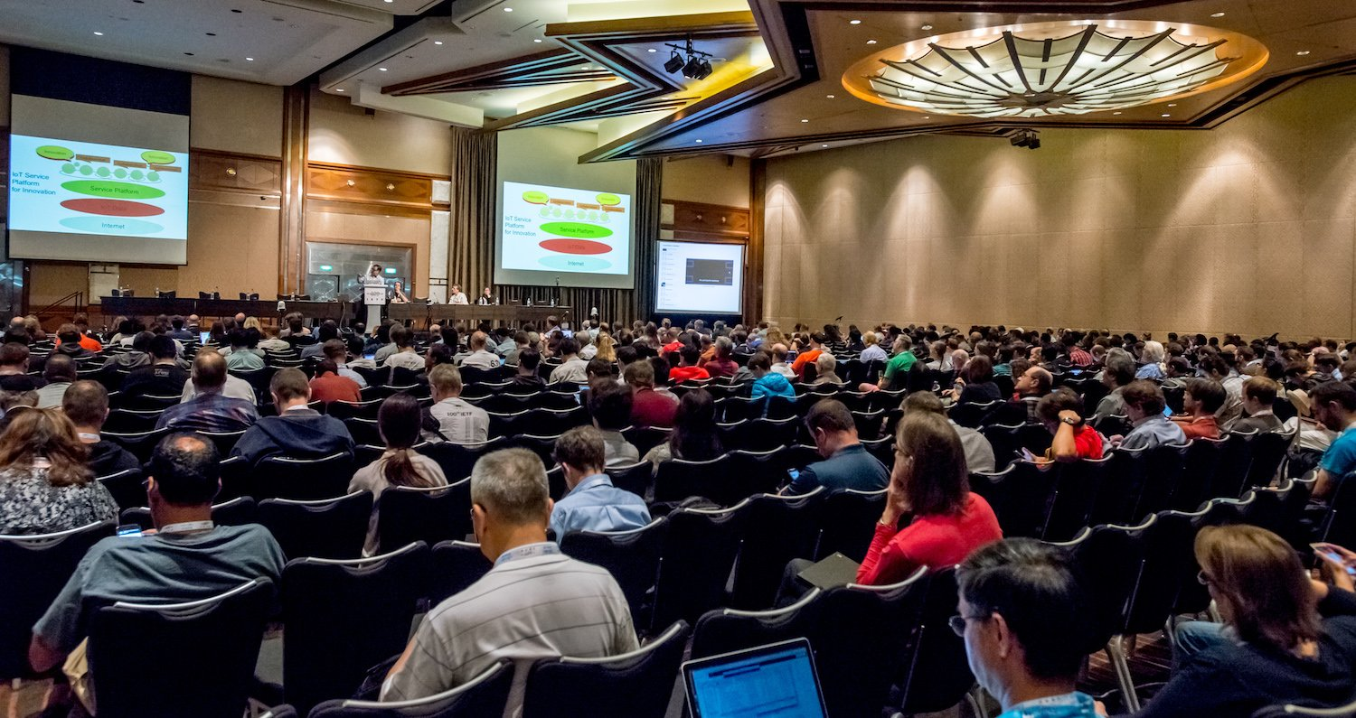
Plenary
Source: https://www.ietf.org/blog/highlights-ietf-100/

Slide 18
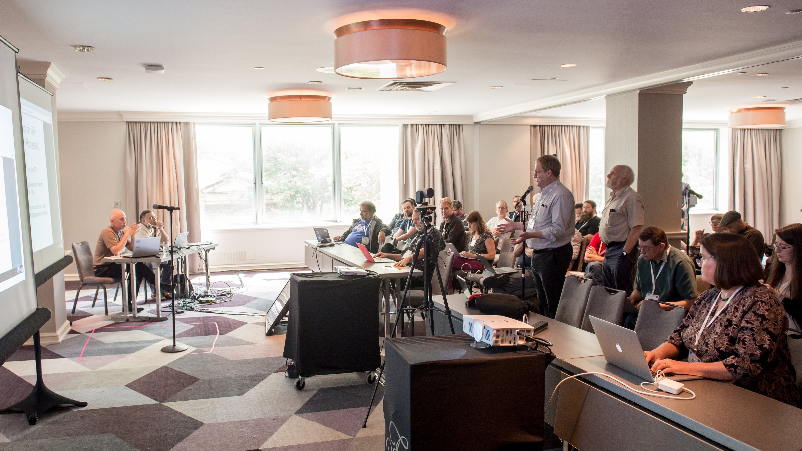
WG Session
Source: https://www.ietf.org/blog/highlights-ietf-102/

Slide 19
How to become visible and useful contributor?
Review the WG charter, milestones
Subscribe to mailing list
Don’t be overwhelmed
Speak up, ask questions, provide answers
You are (most certainly) going to be wrong, or at least ignorant about many of the things
People will be happy to correct you or point you to useful resources
Contribute
Reading drafts and asking questions, providing feedback, etc.
Taking notes
Writing drafts - A draft is not a paper
Do this in parallel to your “normal” research
It’s more intense (publications are more often), but the steps are smaller
Think “Continuous Assessment” vs “End Semester Examination” (research paper)
Can feed into your research, and vice-versa

Slide 20
Environmental Impacts of Internet Technology
The E-Impact Program is a venue for discussing environmental impacts and sustainability of Internet technology.
Within this scope, the program looks at trends, issues, improvement opportunities, ideas, best practices, and subsequent direction of work related to Internet technology, architecture, and operations, including visibility and efficiency on energy and other environmentally-impacting attributes.
In particular, the group focuses on Internet architecture's role in these topics.
https://datatracker.ietf.org/

Slide 21
New WG to be formed: Getting Ready for Energy-Efficient Networking (GREEN)
As the desire to improve energy efficiency gains momentum, network operators increasingly focus on understanding energy consumption by different links, nodes, and devices/components within their networks. Network Energy-efficiency management involves deploying and managing network infrastructures with the dual goals of optimizing energy use and minimizing environmental impact. This will involve technologies to monitor energy consumption, evaluate the effectiveness of energy saving polices, use control strategies to improve energy efficiency, and foster sustainability in network operations.
This BoF is intended to discuss these objectives and determine whether there is a community of interest to work on these topics within the IETF through a new working group (provisionally called GREEN).
The BoF discussion should identify a suite of short-term deliverables aimed at enhancing energy efficiency within networks. Key objectives include standardizing terms and definitions for energy metrics, and YANG models for reporting energy consumption usage and performing energy management. Additionally, the group could create a framework to describe the effective collection and utilization of these metrics and attributes. The proposed approach is to tackle energy efficiency challenges in a systematic and incremental manner, focusing on practical building blocks that contribute to overarching energy efficiency goals.
https://datatracker.ietf.org/

Slide 22
If you want to go fast,
go alone.
If you want to go far,
Use rough consensus and running code
(Re-imagining proverbs the IETF way)
Questions?

